Slide 1

SOUNDLEADERSHIP
MASTERING
PERFORMANCE MANAGEMENT
Sandi Hokansson
Executive Coach & CEO
“The best leaders are both
teachers and students”

Slide 2
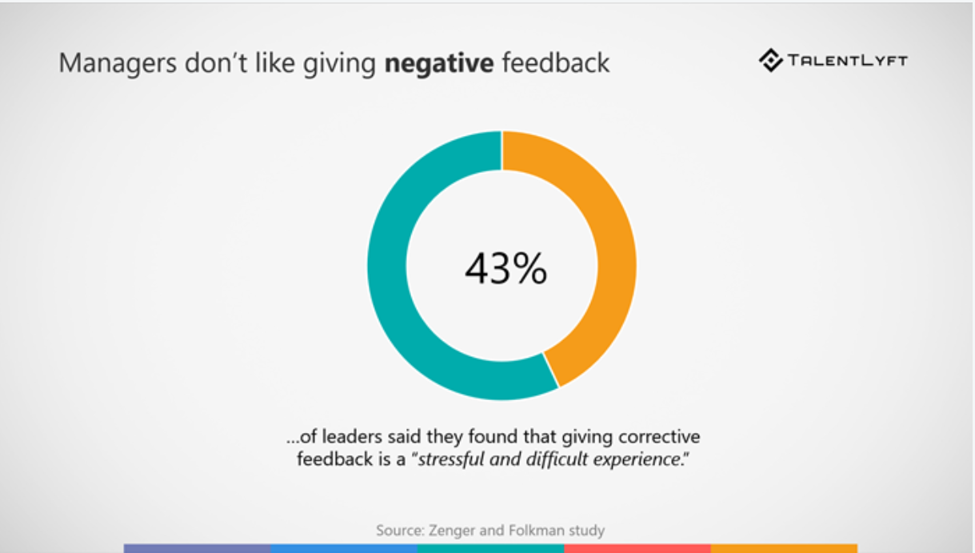
Surprise! Managers/Leaders don’t like giving negative feedback

Slide 3
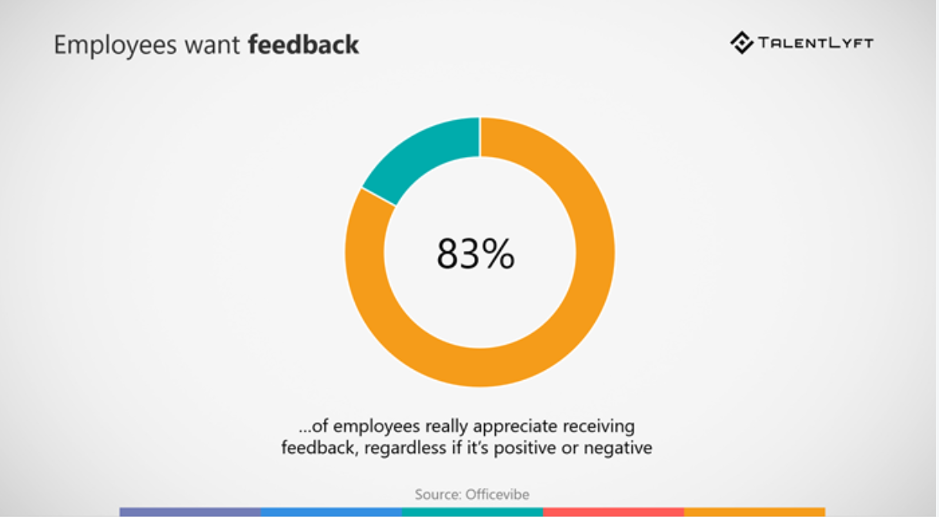
Employees want feedback

Slide 4
Employees want feedback and growth
Employees want to know
  How they are doing
  What they need to do to be successful
  That his/her contributions are recognized and valued
Employees want to have:
  Opportunities to grow and develop
  Learning for learnings’ sake
  Individualized support and personalization

Slide 5
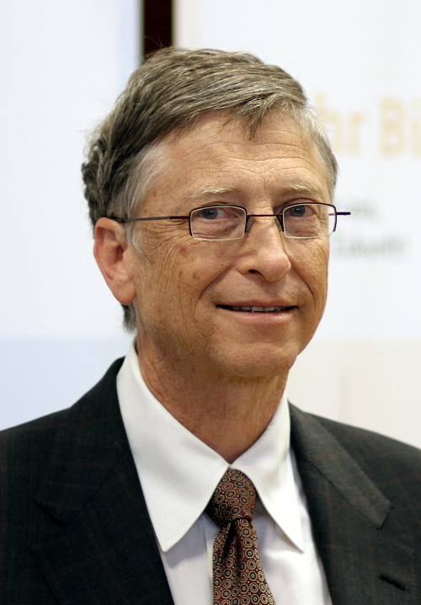
Employees want feedback and growth
“We all need people who give us feedback. That’s how we improve”
Bill Gates
This Photo by Unknown Author is licensed under CC BY-SA

Slide 6
Definition: performance management
A two-way, continuous process of observation, planning and coaching that occurs throughout the year.
When done well, the process moves the organization forward and raises the performance bar of all colleagues
Focus performance management efforts on improving business results
Shift accountability and ownership of managing performance to individuals
Make performance management “the way we run the business”
Utilize Coaching
Notes:
let’s look at a performance management definition – there are many good definitions out there to use.
Perf management is a two-way continuous process of setting expectations, observation, planning and coaching that occurs throughout the year.
When well done, the process moves the organization forward towards its goals and raises the performance bar of all colleagues
That is what we are all working towards and the goal here today is to have you leave feeling that you have a greater mastery of the perf mgmt. process and if you are tasked with leading the process in your organization, the goal for today is that you pick up one or two new ideas to augment your existing program.
ACCORDING TO THE “WAR FOR TALENT” RESEARCH CONDUCTED BY MCKINSEY AND SIBSON. ONLY 30% OF EMPLOYEES SAY THEY RECEIVE FEEDBACK OF REAL VALUE IN IMPROVING THEIR PERFORMANCE, That leaves all of us huge room for improvement.
However, COMPANIES THAT HAVE MADE ONE OR MORE OF THE following THREE SHIFTS HAVE IMPROVED THE GROWTH RATE OF THE COMPANY AND HAVE REDUCED UNWANTED EMPLOYEE TURNOVER.
And these are:
Focusing performance management efforts on improving
business results
Shifting accountability and ownership of managing
performance to individuals
Making performance management “the way we run the business” and
Utilizing Coaching
The more integrated you can make performance management into the way you to business , the more success you will have.

Slide 7
Comprehensive performance management
Regular Feedback (Positive & Negative)
Internal Coaching
External Coaching
Peer Feedback/360
Training
One on Ones
Performance Reviews
Talent Reviews
Upward Communication

Slide 8
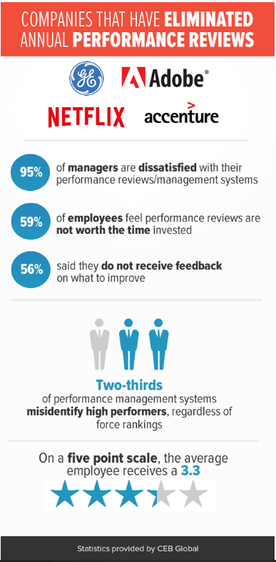
Trends in performance management

Slide 9
Table Discussion
Discuss the Value of Annual Performance Reviews

Slide 10
Findings: eliminating annual review
Manager conversation quality declined by 14%
Managers spent less time on informal reviews conversations
Top performers’ satisfaction with pay differentiation decreased by 8%
Employee engagement dropped by 10%

Slide 11
JIT Coaching – The “Always On” Manager
The “Always-on” manager represents the preferred coaching approach for many organizations, but this approach — providing continuous coaching and feedback across a broad range of skills — actually degrades employee performance
Gartner Research 2019

Slide 12
Trends in performance management
More companies moving to ‘JIT’ feedback – “Coaching organizations” “The Always On” Manager – continuous real time feedback gaining groun
Movement to more frequent check in’s
Greater importance of 1 on 1’s throughout year
Upward Feedback increasing
Online Processes & People Analytics
Simplification vs. complexity
Focus on the ‘Employee Experience’
Individualized employee support, tailored feedback and coaching
Notes:
There are however some smaller steps organization can take and are taking that are becoming trends such as increasing the frequency of check in’s and making a renewed commitment to having one on ones on a regular basis.
We are also seeing an increase in:
Upward Feedback
A move to take performance and feedback Online which drives more people analytics
Working to keep the perf mgmt. system simple
A Focus on the Employee Experience and more
Individualized Employee Support

Slide 13
What is coaching?
“Coaching is an intentional process that creates a compelling environment for growth and effective action.”
“Coaching is a one-on-one process, with specific objectives and goals focused on development potential improving relationships and enhancing performance.”

Slide 14
What do coaches do?
What do coaches do?
  Create a safe environment in which people see themselves clearly
They do this by?
  Listening, asking focused questions, reflecting back, challenging and acknowledging the employee
  Meeting employees where they are
  Getting to know their employees, personality assessments
  Learning what motivates them

Slide 15
Creating a coaching organization does NOT happen by itself
Safe Environment
Senior Buy In
Training & Coaching
CPI Philosophy
Upward Communication
360

Slide 16
Purpose & value
Companies with strong performance management programs:
  Post higher profits
  Have better cash flow
  Higher stock value
  Show higher sales growth per employee
  Lower turnover (costs of turnover: recruiting & selection; orientation & training; loss of customers & IP; reduced productivity; decreased morale)

Slide 17
Purpose & value
Hewitt Associates Survey
  Companies are only as good as their employees
  A strong performance management program is a powerful way of developing staff and maximizing their potential

Slide 18
Performance reviews may/should include:
Self evaluation
Written appraisal tied to company values, job requirements and employee contributions
Strategic plans
Goal setting tied to performance objectives for upcoming year
Action plans if need for improvement
Career discussion and career planning opportunity
Upward feedback

Slide 19
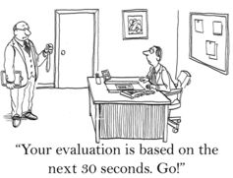
Preparation for the review
Notes:
I
Nothing is worse than feeling like your boss is not prepared for your review or is only basing your review on very recent performance - good or bad, and not an entire year’s work.
Line managers are not the only ones who need to prepare for reviews.
There is work to be done by the employee, the Senior leadership team and HR team and the direct manager/leader
Lets have a look at each role

Slide 20
Preparation for the review
Employees
HR & Senior Leadership
Managers/Leaders
Self evaluation (strengths & weaknesses & top contributions)
One on one’s review
Prepare upward feedback
Career reflection
Gain senior buy in
Set standards in ratings and how to apply ratings
Conduct training for employees and managers
Set expectations with employees
Prior performance reviews & job description review
One on one’s review
Results to goals: KPIs, etc., specific examples
Tailor feedback to the individual
Role play giving courageous feedback
Reflect on leadership
Career planning for individual
Be open to feedback

Slide 21
Gaining buy in from senior leaders
Educate on employee’s needs for feedback
Educate on trends in industry/peers/leaders in field
Tie to business need
Speak in terms of outcomes - Make lack of talent development measurable by tracking cost of turnover, cost of time to hire vs. promoting from within, skills gap, etc.
Discuss value of role models
Simplify the CEO-1 format

Slide 22
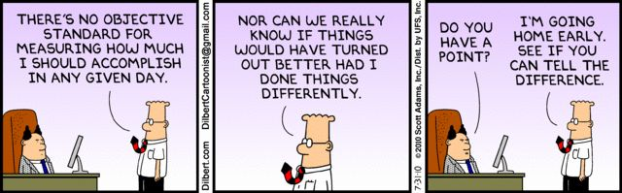
Managing Ratings

Slide 23
Managing ratings: making them fair and consistent
Follow company guidelines, be consistent and communicate ratings guidelines
Make the training mandatory
Clarify whether pay is linked to performance and ensure your leaders how to explain it
Train leaders on how to Rank their teams
Develop a process to identify top performers
Preparation is key - good notes will provide specific examples of performance
Qualitative and quantitative performance indicators – can’t have one without the other
Recognize that rating people is difficult and performance expectations differ person-to-person
Consider having HR review the leaders ratings prior to delivery as a check point

Slide 24
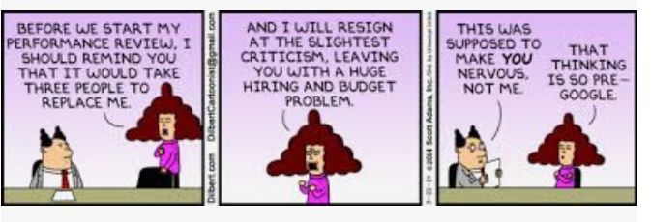
Delivering the review: tailoring to the individual

Slide 25
Delivering the review: tailoring to the individual
Different ways to give feedback
People respond differently to feedback
Use a personality assessment if possible
Observe behaviour
Adjust style to accommodate
  ie. sensitive perfectionist – more subtle
  ie. star expert – more direct
  If you don’t yet know your employee, ask them!
  “I would like to offer you regular feedback that will help you learn and grown. Can you teach me how to give you feedback that will motivate you?”
Gartner Research: “Connector” managers are defined by their ability to personalize employee development for employee resonance, power the team for peer development and partner for best-fit connections. This triples the likelihood that their direct reports are high performers, and also drives employee engagement by up to 40%.

Slide 26
Delivering the review: supportive environment
Find a disruption free environment
The purpose is to assist in achieving success, not to punish or embarrass
Allow the employee an opportunity to explain
Offer help and support
Don’t forget to talk about the things he/she does right

Slide 27
Delivering the review
Timely
Specific
Owned by the Giver
Understood by the Receiver
Provide feedback as close as possible to the occurrence
No surprises
Waiting to address poor performance may cause resentment
Do not make vague generalizations
Describe the behaviour in exact terms
Use personal pronouns such as “I” and “my”
Avoid expressions beginning with “you”, such as “you” are always late
Always confirm understanding of both the intent and the expectations

Slide 28
Delivering the review: action plan for development areas/leverage strengths
TOGETHER, develop a plan for improving performance or leveraging strengths
Agree on deadlines and measures
Review progress

Slide 29
Delivering the review: dealing with conflict
How to deal effectively with conflict:
  Recognize that a conflict exists
  Define the area of disagreement
  State desired outcomes
  Identify benefits of reaching agreement vs. consequences of not
  Generate alternatives
  Select the best alternative
  Implement and follow up

Slide 30
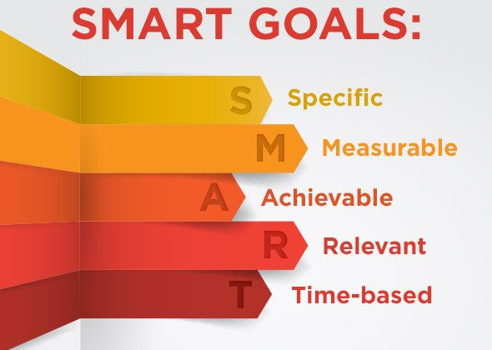
Goals

Slide 31

Career Discussion: Make it safe to fail
“The courage of leadership is giving others the chance to succeed even though you bear the responsibility for getting things done.”
Simon Sinek

Slide 32
Career discussion
Review career roadmap – historical and future tied to performance
Encourage employee to share career goals and timeline
Discuss gaps to goals and how the individual might reach them
Consider stretch assignments, job shadowing, peer coaching, etc.
Set at least one career development goal with the other performance-based goals
If top talent, communicate the talent development and promotion career path – next steps. Make commitments in writing regarding development

Slide 33
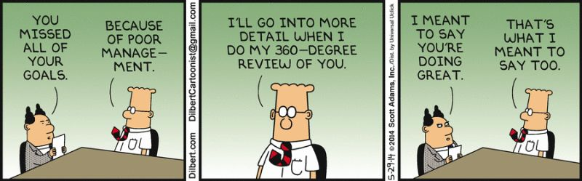
Upward communication

Slide 34
Upward communication
Growing in adoption
Two-way feedback is important to deepen any relationship and create trust
Key learning opportunity for manager/leader
A step towards 360 review
Works best if company is committed to 360 leader reviews and leaders are used to receiving feedback
Safe environment a musts if not, feedback will not be honest
Google, an early adopter, publishes their form online

Slide 35
Tying it all together
CONNECT
Employees want Feedback & Growth
ROI of Performance Management
Executive Commitment
Coaching
Philosophy & Tailoring Feedback
Performance Review Best Practices
Upward Feedback

Slide 36
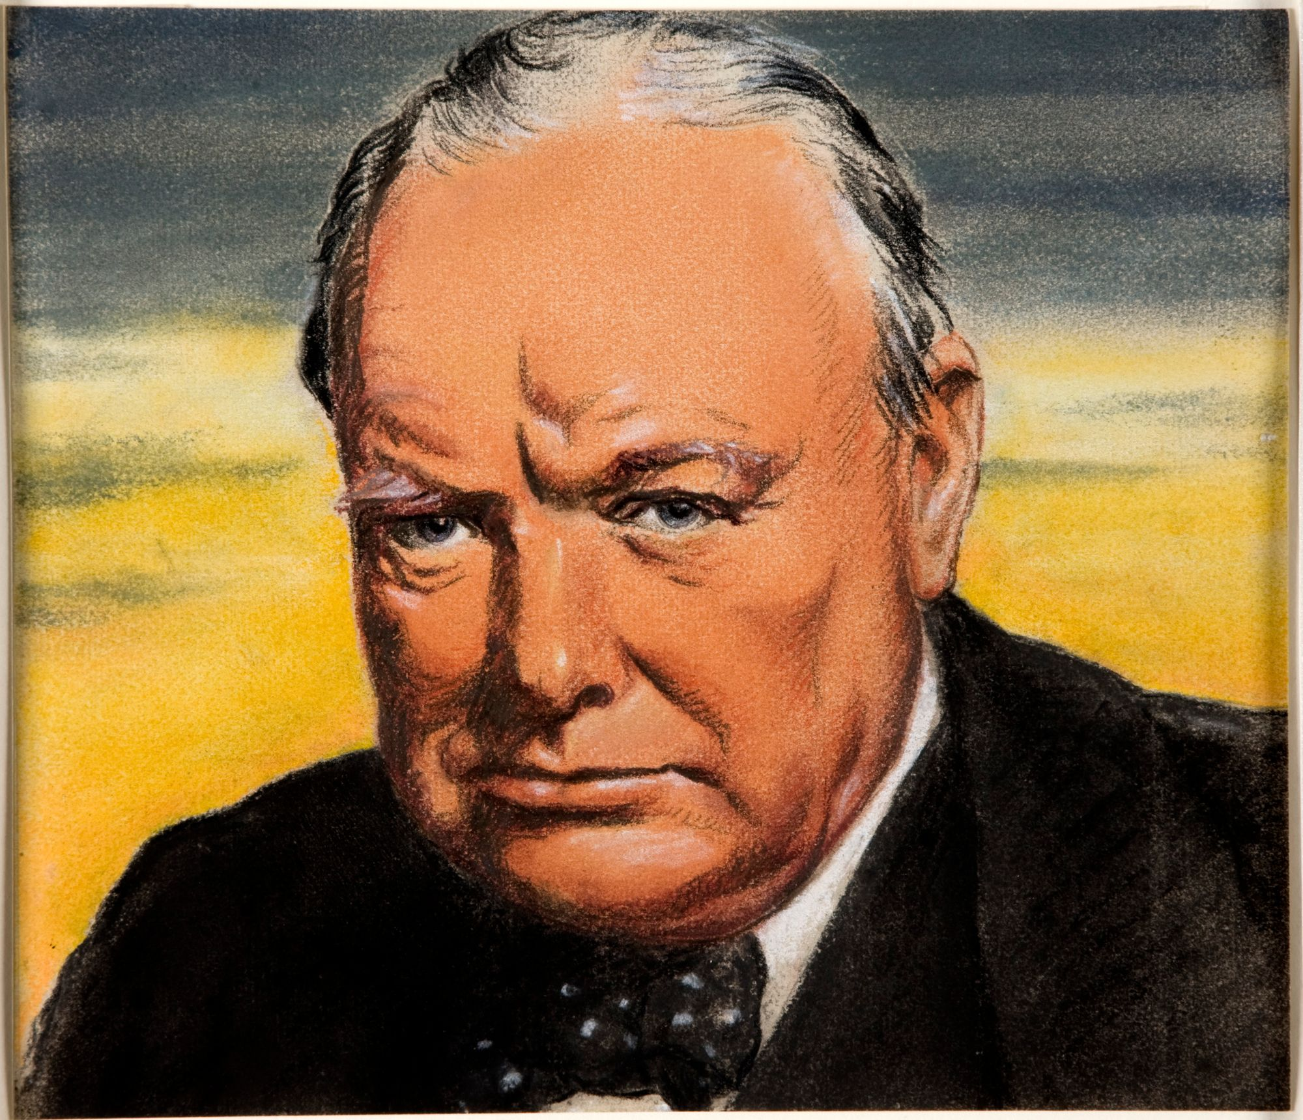
“Courage is what it takes to stand up and speak. It is also what it takes to sit down and listen.”
Winston Churchill

Slide 37
SOUNDLEADERSHIP
Questions?
Contact: Sandi@soundleadership.ca www.soundleadership.ca
Leadership Coaching
Leadership Training
Leadership Assessment
“The best leaders are both
teachers and students”

